Slide 1



ECE327 - Introduction to Software Engineering
Lab 1 - Linux/Unix Tutorial
Your First Technical Course for Industry Preparation
Shuyue Jia
Ph.D. student
Boston University

Slide 2
Outline
Lab 1 - Linux/Unix Tutorial
2
Introduction to Linux/Unix
The Linux Shell
Files and Directories
Navigating Through Directories
Commands for Files
Code Editors
Security and Access Rights
Check Manuals
Zipping Files and Directories

Slide 3
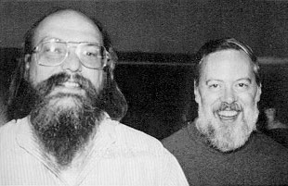

Part 1 – Introduction to Linux/Unix
Lab 1 - Linux/Unix Tutorial
3
Linux/Unix: Computer Operating System (OS)
Unix: Proprietary, developed at AT&T Bell Labs in the 1970s
By Kenneth Lane Thompson & Dennis Ritchie (Father of C)
ACM A. M. Turing Award, 1983 (Ken and Dennis)
Linux: Free and open-source, developed by Linus Torvalds in the 1990s
Core Philosophy:
Small, modular utilities that perform tasks well
Combine tools through pipelines to solve problems
Image Credits:
Ken Thompson and Dennis Ritchie 1973: in the public domain
Linus Torvalds: CC BY 3.0

Slide 4
Part 1 – Introduction to Linux/Unix
Lab 1 - Linux/Unix Tutorial
4
Key Features:
Portability: runs on various hardware platforms
Multiuser Support: multiple users at the same time
Multitasking: multiple processes at the same time
Hierarchical File System: organized directory structure
Security: permissions and user roles
Standardization and Foundation for Modern OS
Portable Operating System Interface (POSIX), IEEE 1003/ISO/IEC 9945
Linux and macOS

Slide 5
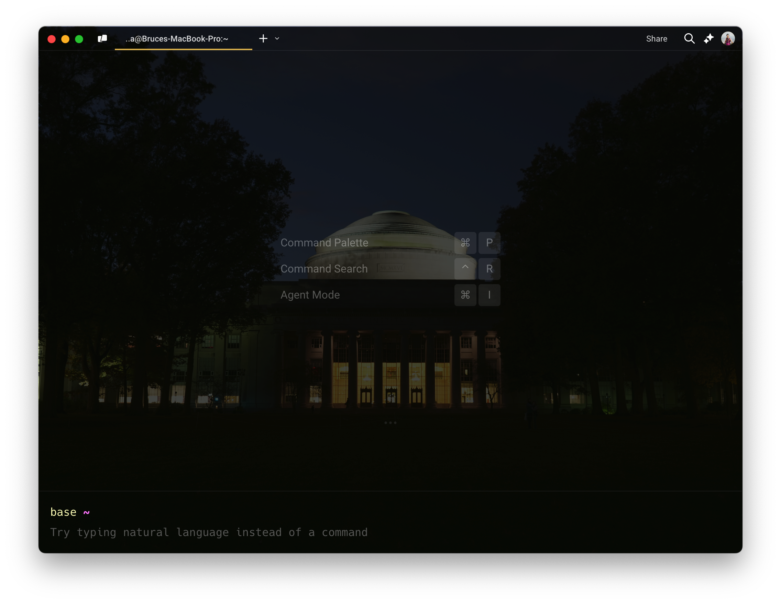
Part 2 – The Linux Shell – Shells
Lab 1 - Linux/Unix Tutorial
5
Textual UI to the OS kernel
Accessible via the Terminal
macOS
Terminal
Hyper
Warp
iTerm2

Slide 6

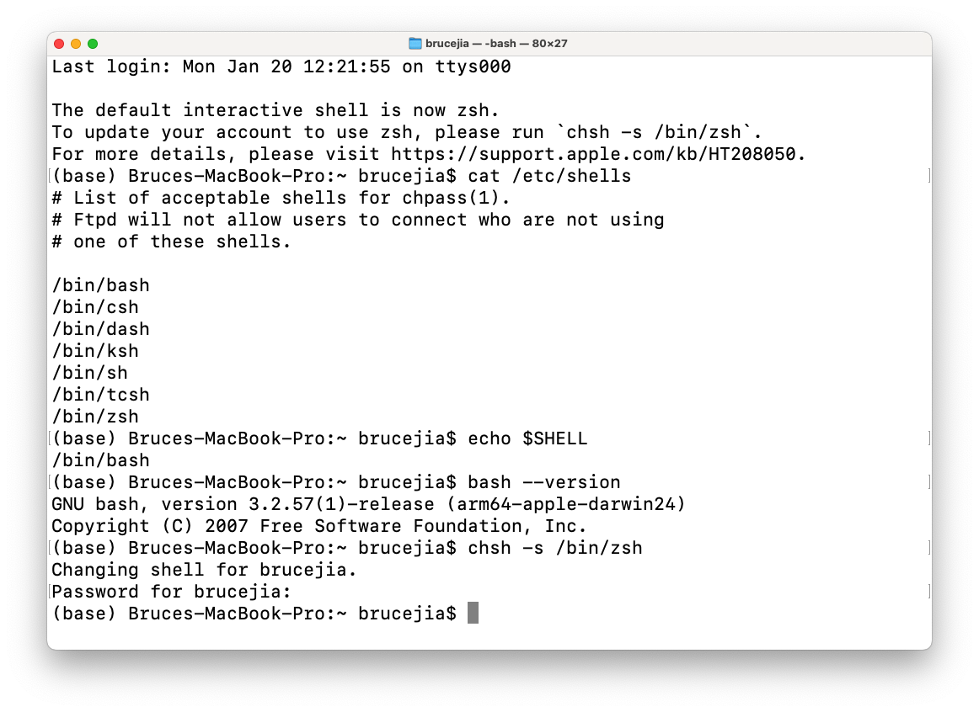
Part 2 – The Linux Shell – Zsh
Lab 1 - Linux/Unix Tutorial
5
Oh My Zsh
Installation
Themes
Plugins
Autosuggestions Syntax-Highlighting Autocomplete
Image Credits: Oh My Zsh

Slide 7
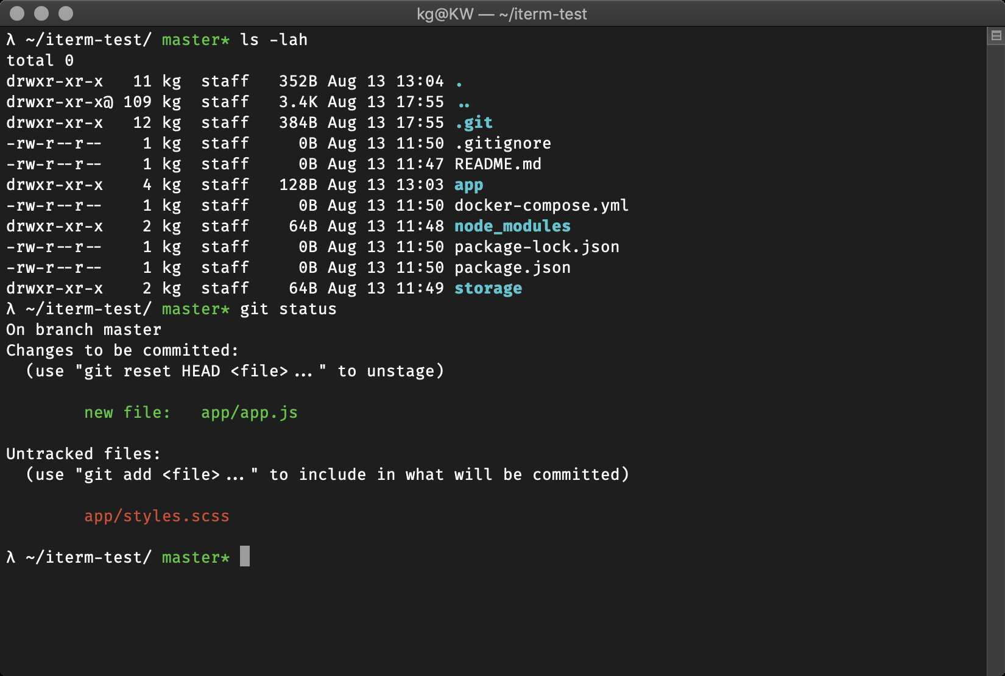
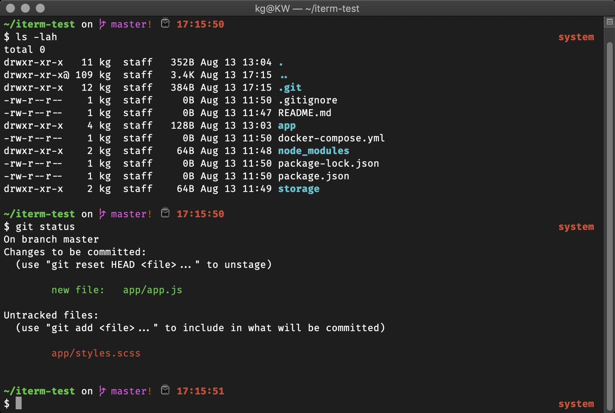
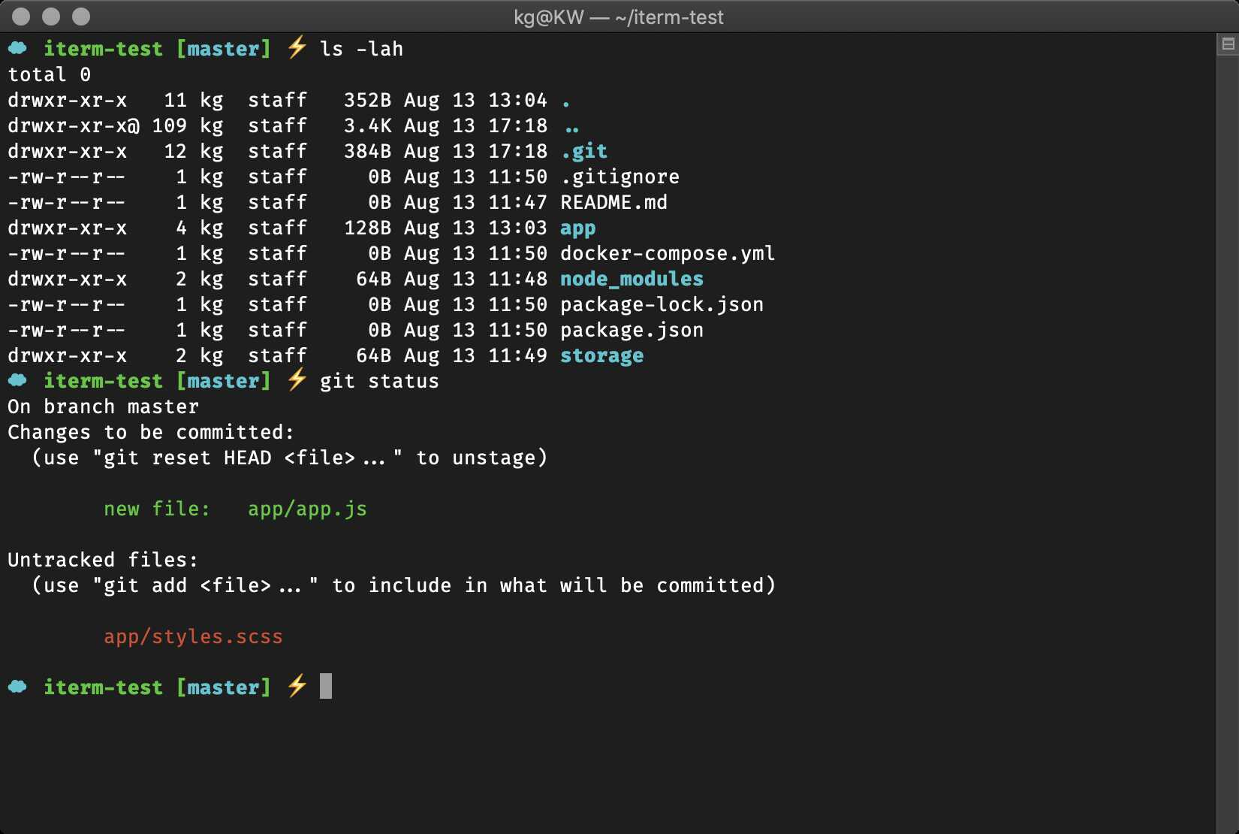
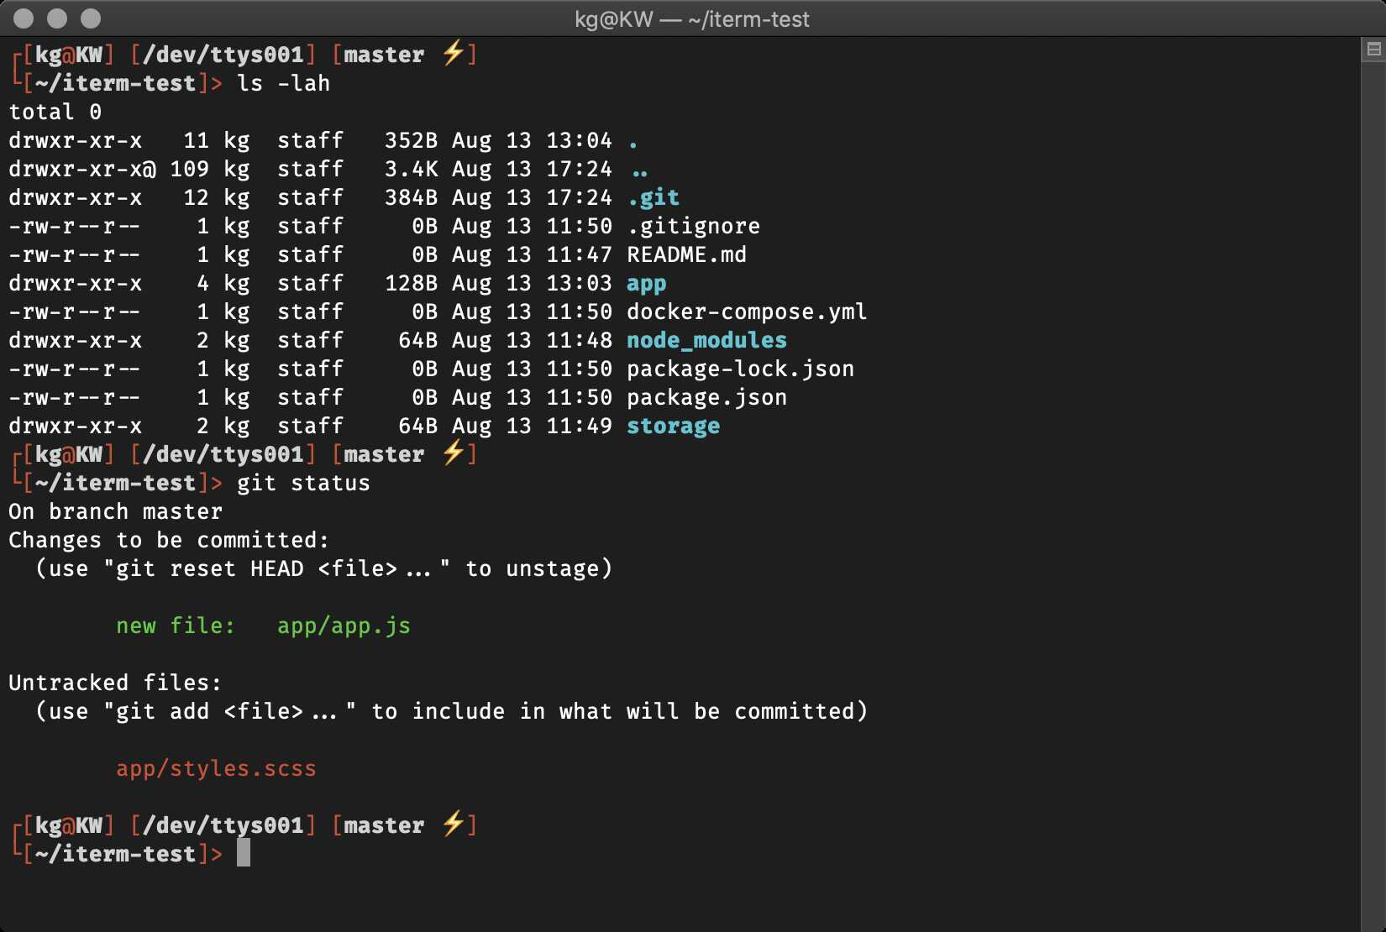
Part 2 – The Linux Shell – Themes
Lab 1 - Linux/Unix Tutorial
5
lambda
amuse
cloud
darkblood
cloud

Slide 8
Part 2 – The Linux Shell – Plugins
Lab 1 - Linux/Unix Tutorial
5
Oh My Zsh
Installation
Themes
Plugins
Autosuggestions Syntax-Highlighting Autocomplete
Image Credits: Oh My Zsh

Slide 9
Part 2 – The Linux Shell
Lab 1 - Linux/Unix Tutorial
6
Nice Features of Terminal
History: Up/Down Arrows
history
Auto-completion: Tab key
Mostly every command takes arguments
<command> [<list of arguments>]
ls –l
cd ./my/directory

Slide 10
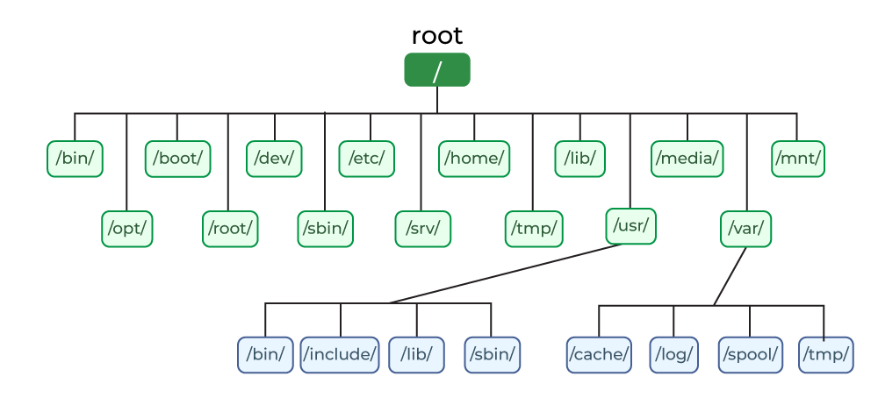
Part 3 – Files and Directories
Lab 1 - Linux/Unix Tutorial
7
binary executables
(commands)
boot process (kernel)
hard
disk
config
shared
libraries
temporary mount
software
root superuser account
system
binary
executables
services data
logs, spool files, cache, etc.
user-related programs and data
Image Credits: in the public domain

Slide 11
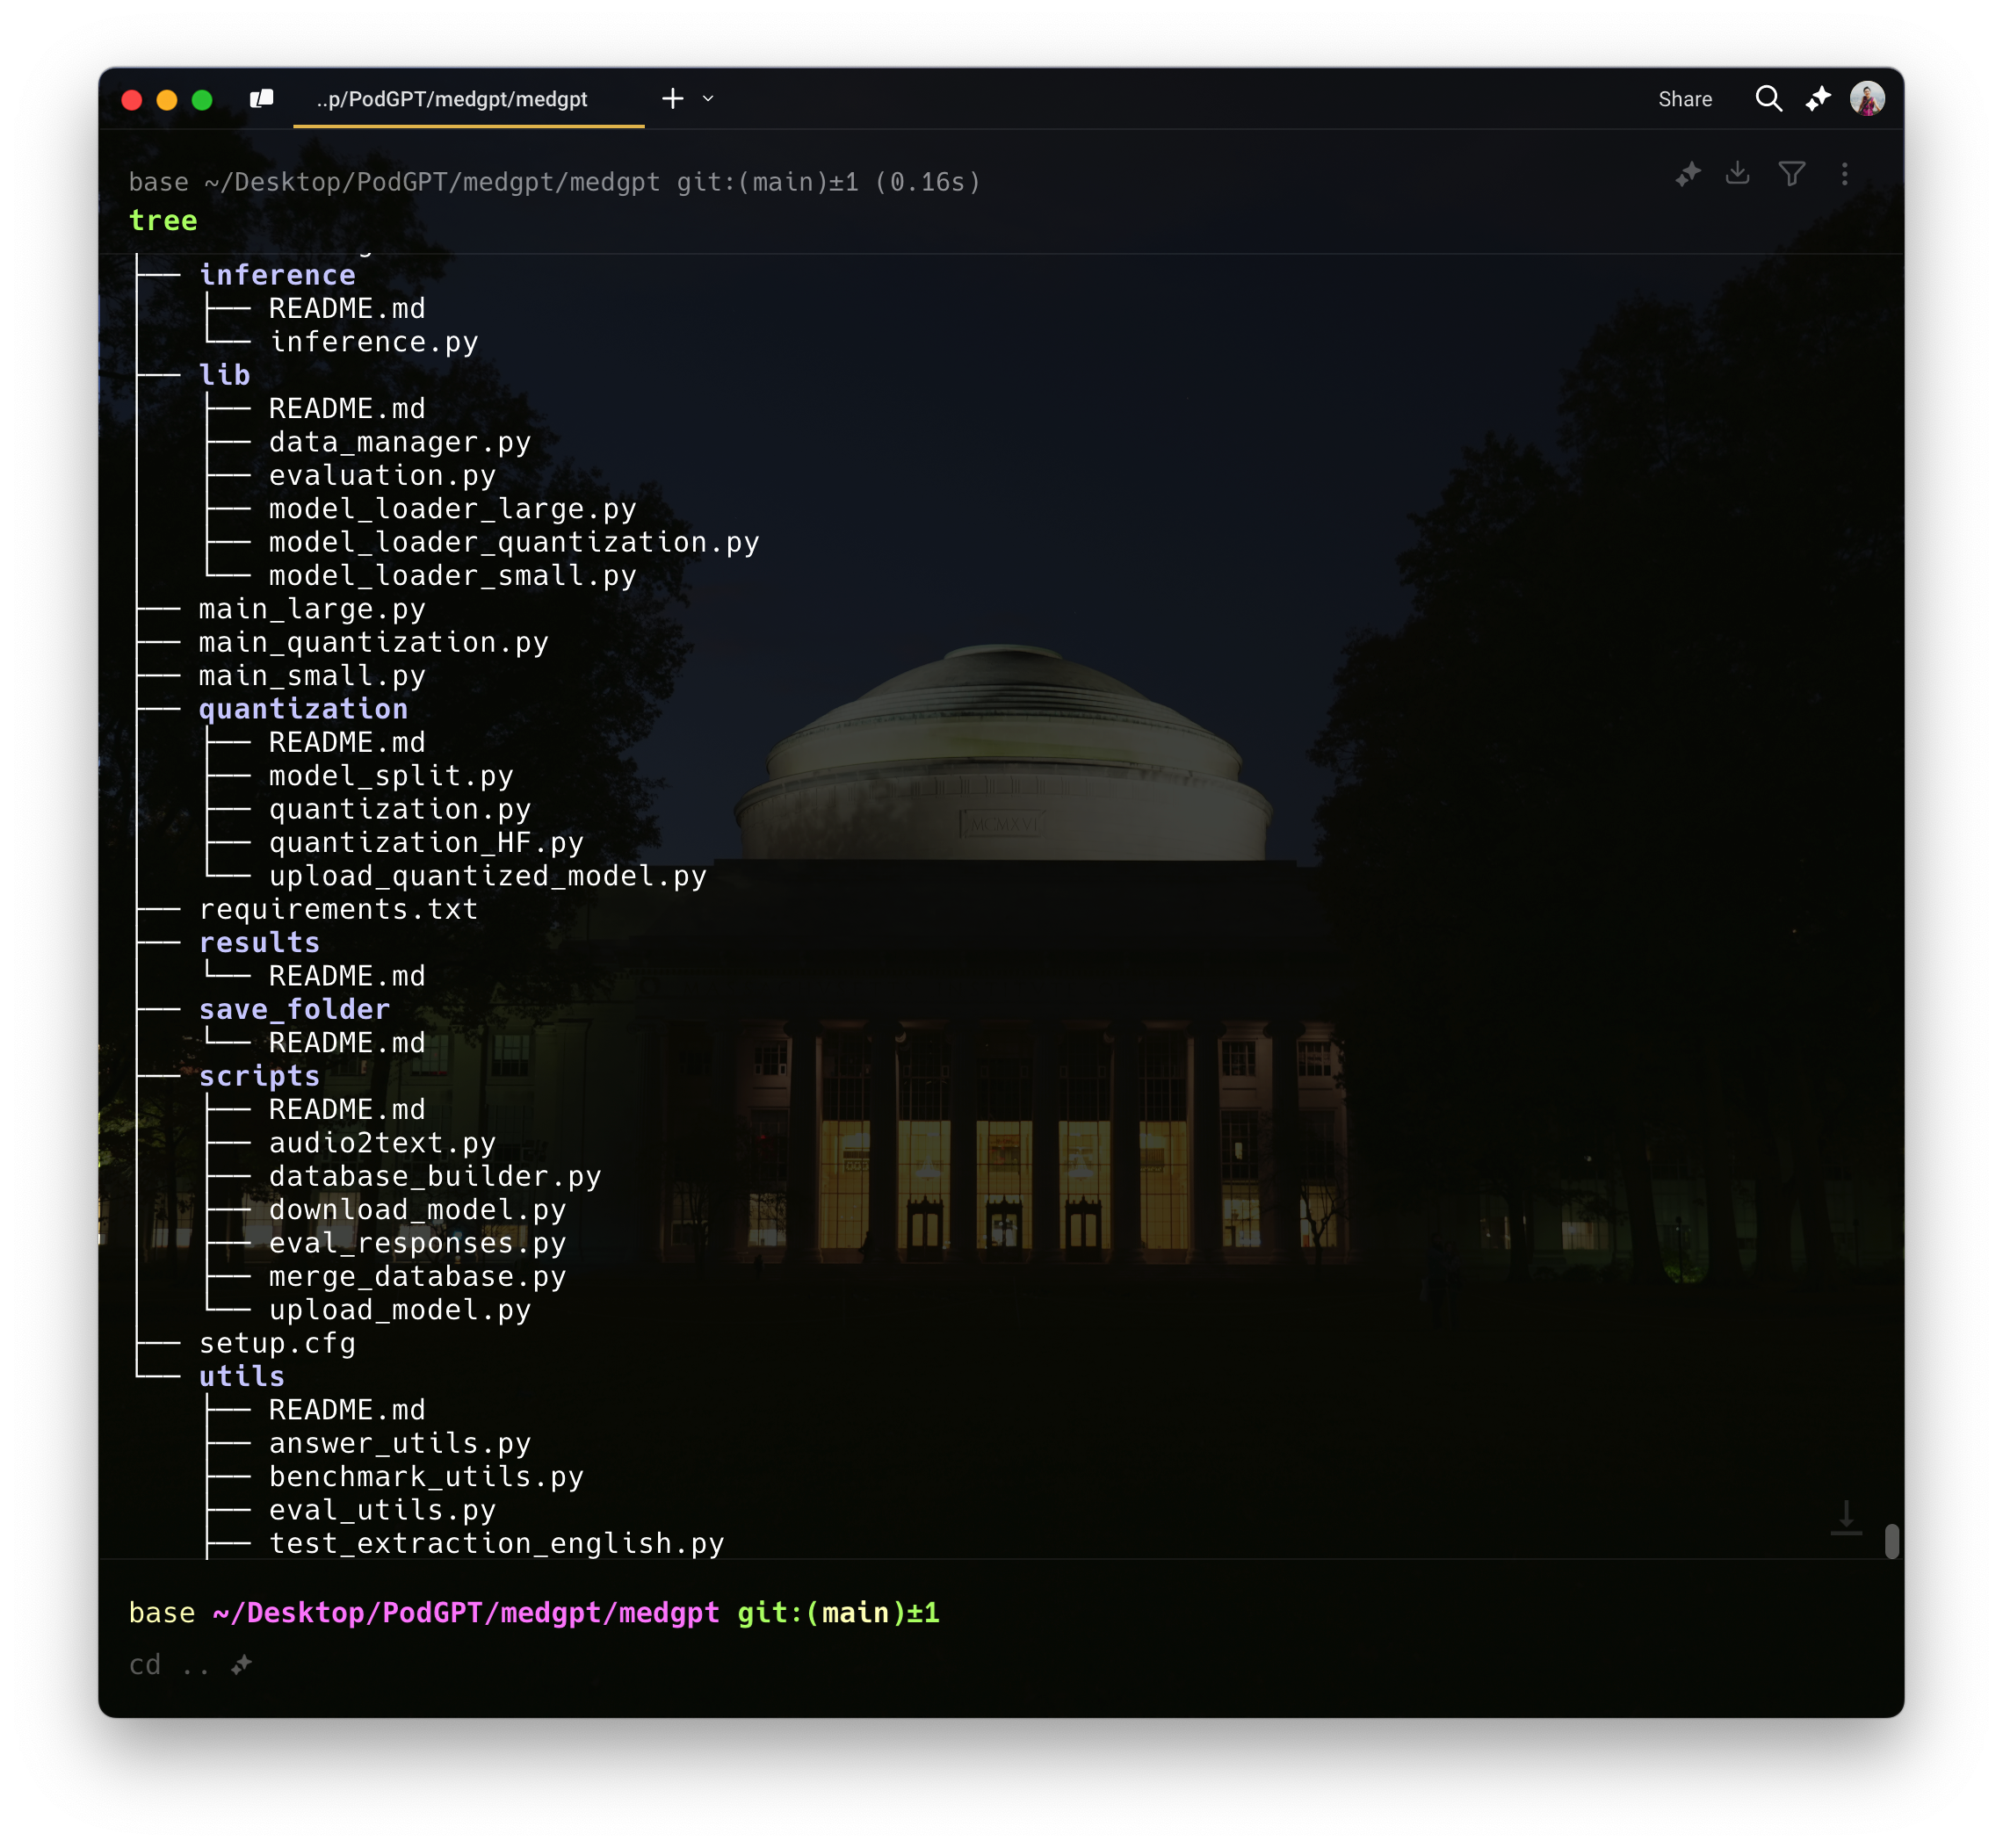
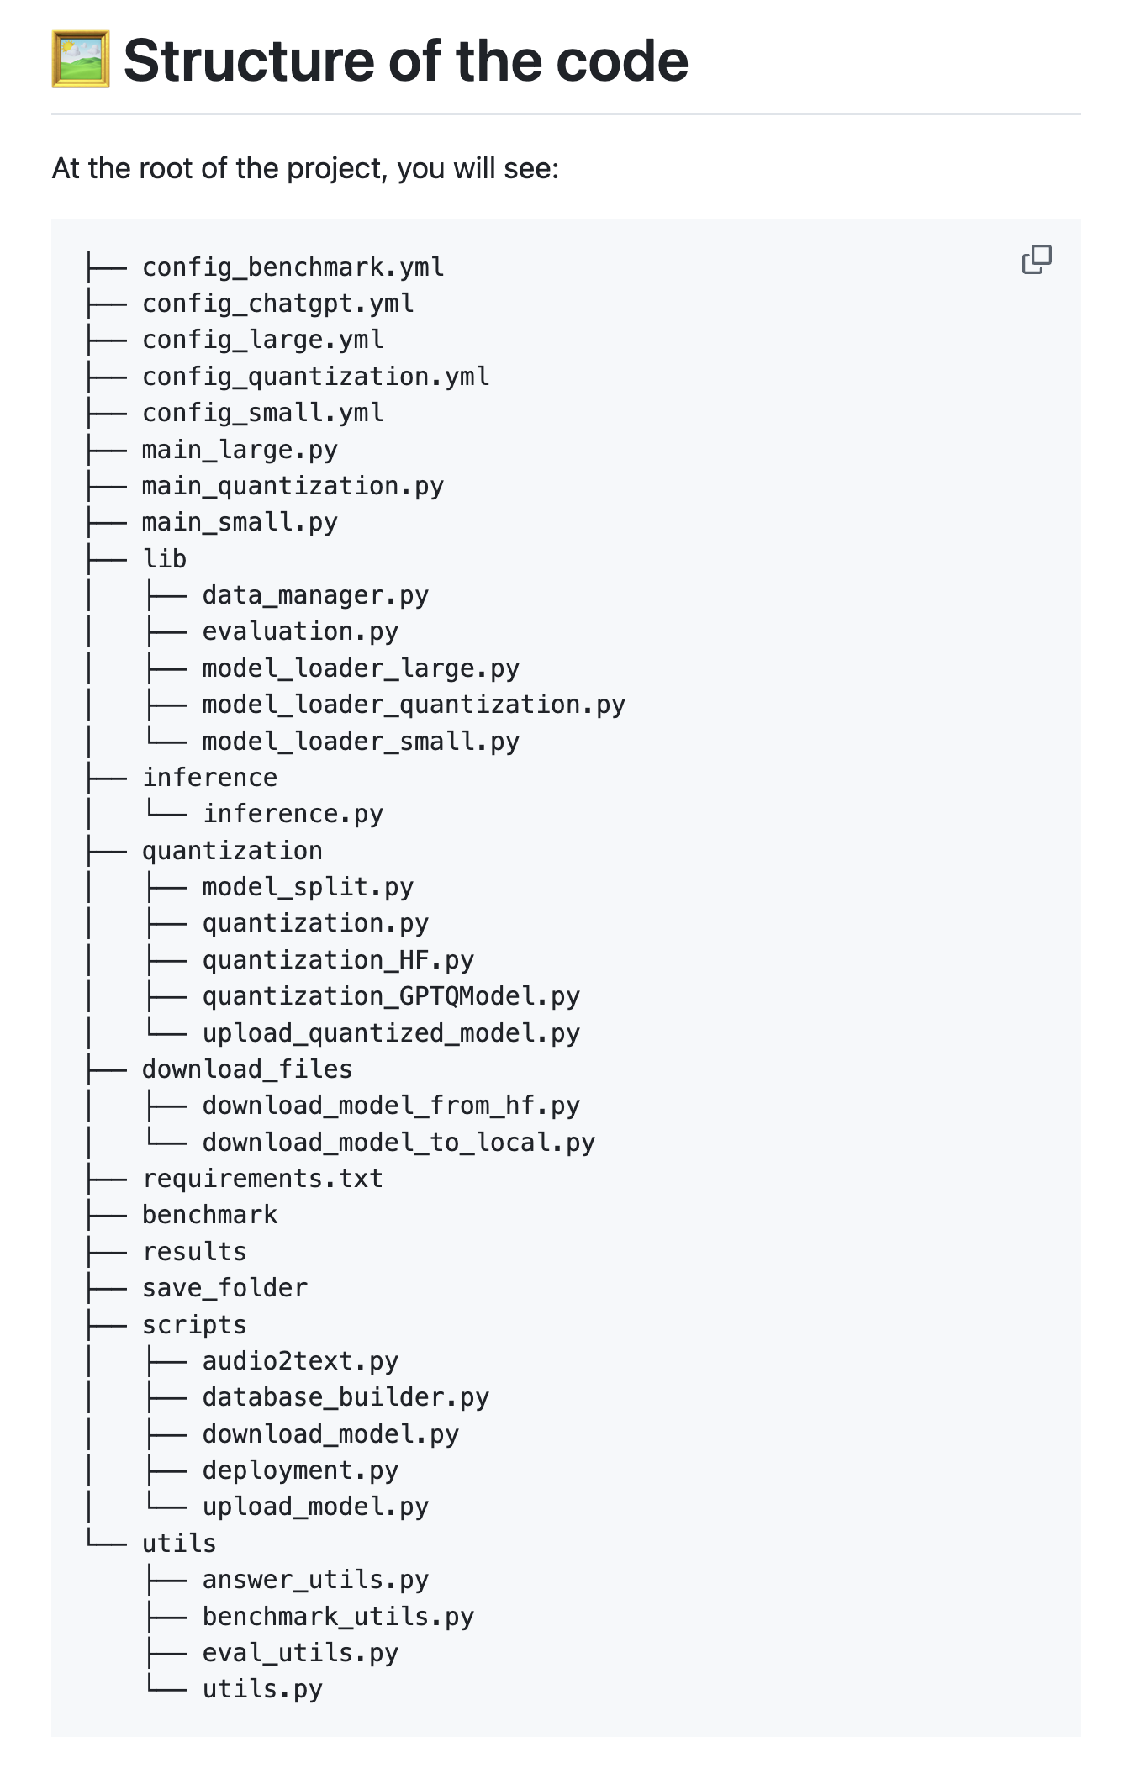
Part 3 – Files and Directories
Lab 1 - Linux/Unix Tutorial
7
$ tree
Image Credits: https://github.com/vkola-lab/PodGPT?tab=readme-ov-file#%EF%B8%8F-structure-of-the-code

Slide 12
Part 3 – Files and Directories – Listing Files
Lab 1 - Linux/Unix Tutorial
8
▪
ls
Lists all files and directories within your current directory
ls -l
Expanded view of files and directories (-l is long listing format)
ls -a
▪
▪
Lists all files including hidden ones (-a is all files)
Names of hidden files start with “.”

Slide 13
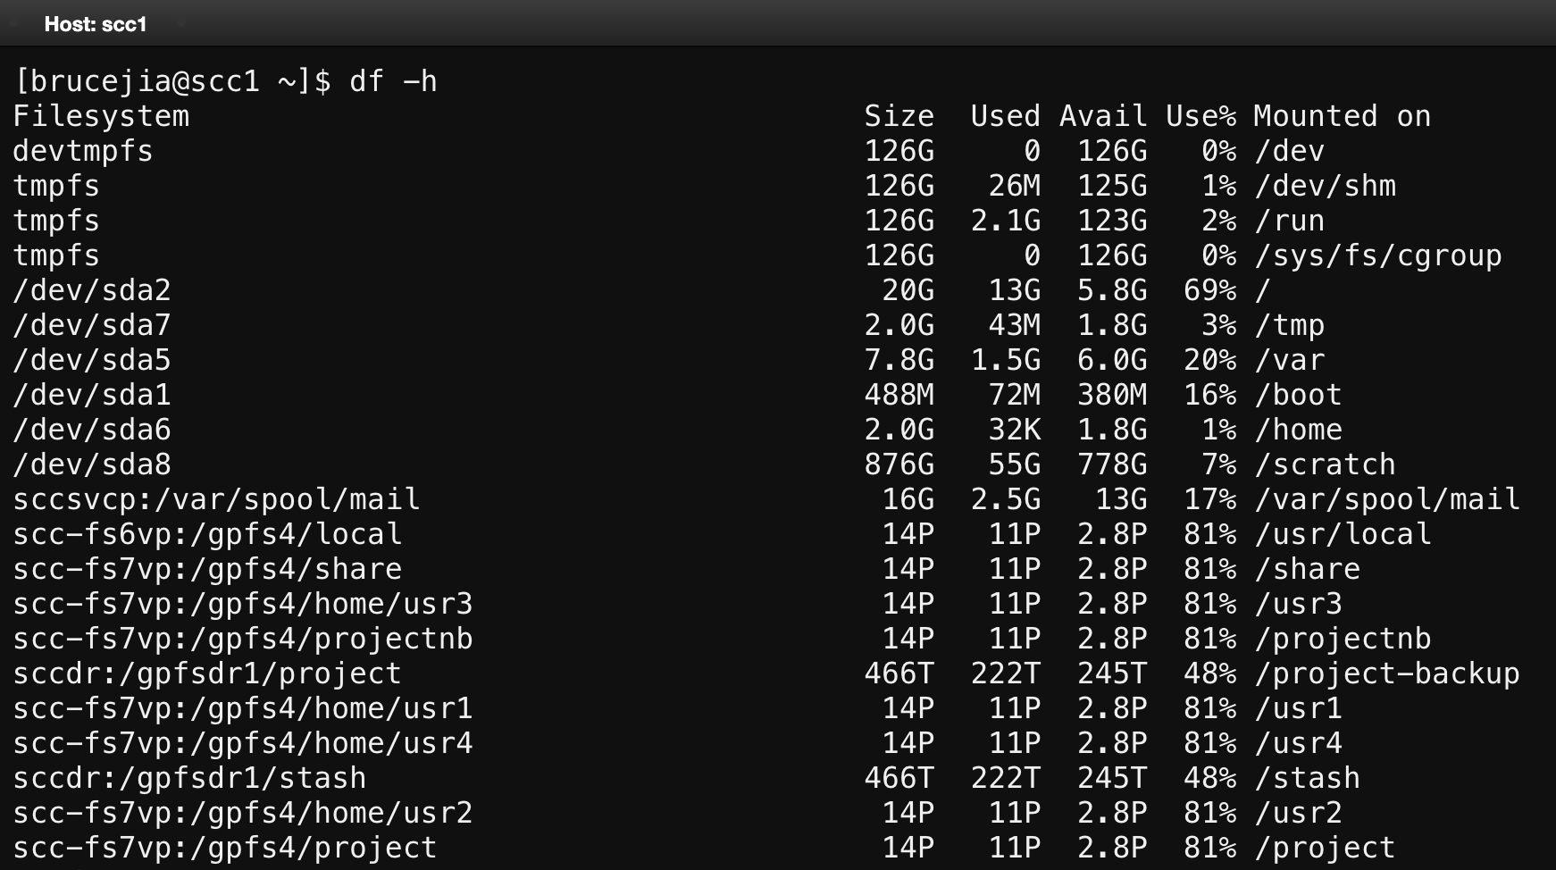
Part 3 – Files and Directories – File Storage
Lab 1 - Linux/Unix Tutorial
8
▪
df -h
Disk free, displays the amount of available disk space on file systems

Slide 14
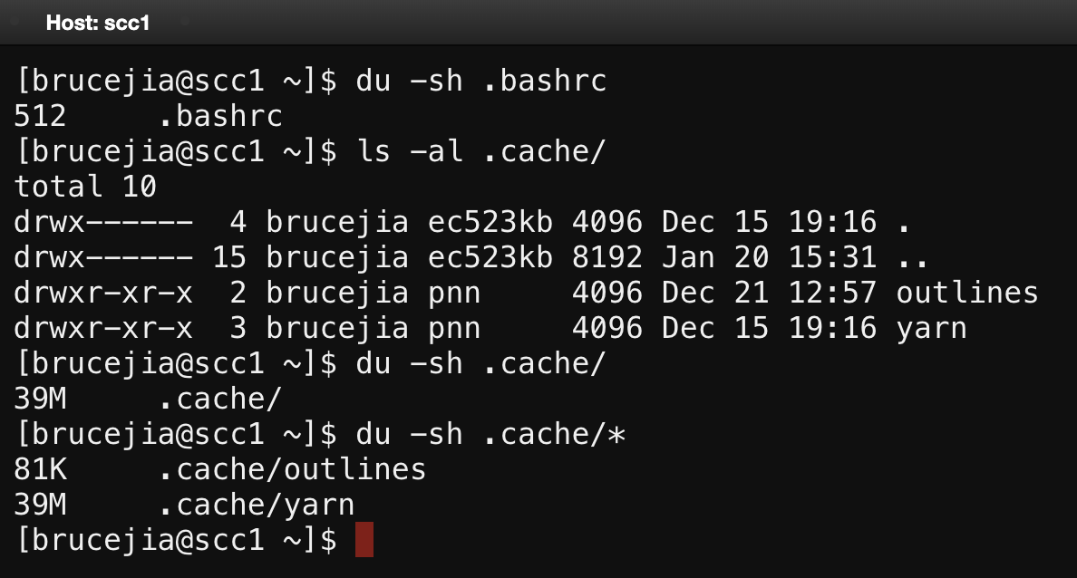
Part 3 – Files and Directories – File Storage
Lab 1 - Linux/Unix Tutorial
8
▪
du -sh
Disk usage, displays detailed information about the disk space
Check a folder’s size
du –sh <folder_name>
Check a file’s zie
du –sh <file_name>
Check the folders’ size inside a folder
du –sh <folder_name>/*

Slide 15
Part 4 – Navigating Through Directories
Lab 1 - Linux/Unix Tutorial
9
▪
pwd: prints working directory
cd : change directory
cd . : go to the current directory
cd .. : go to directory one level above
cd : go to the home directory
cd - : go to the previous directory
▪
▪
▪
Absolute Path : cd /absolute/path/to/directory
Relative Path : cd ./relative/path/to/directory
While you are writing codes,
the relevant path is highly recommended!

Slide 16
Part 5 – Commands for Files
Lab 1 - Linux/Unix Tutorial
10
▪
touch: create a new file
touch main.cpp
mkdir: make a new directory
mkdir EC327_Lab1
cp: copy file
It will NOT open for editing in the Terminal!
▪
▪
Important!
If you want to copy a folder of files,
Please use –r ”recursive”
cp –r source/ destination/
cp main.cpp main01.cpp
cp main.cpp /destination
▪
mv: rename or move file
mv main1.cpp main2.cpp
mv main.cpp /path/to/destination
▪
rm: remove file
rm main.cpp
Important!
If you want to delete a folder of files,
Please use –r ”recursive” and –f “force”
rm –rf source_folder
NOTICE:
Do NOT easily use rm –rf

Slide 17
Part 5 – Commands for Files
Lab 1 - Linux/Unix Tutorial
10
▪
wc: Word count, print number of lines, words, and characters
wc <file_name.txt>
wc -l: print number of lines
wc -l <file_name.txt>
wc -w: print number of words
wc -w <file_name.txt>
wc -c: print number of bytes
wc -c <file_name.txt>
wc -m: print number of characters
wc -m <file_name.txt>
wc -L: print the length of longest (number of characters) line
wc -L <file_name.txt>

Slide 18
Part 5 – Commands for Files – Reading Files
Lab 1 - Linux/Unix Tutorial
11
less <filename>
Example: less stuff.txt
Navigating
spacebar: go to the next page
b : go back a page
q : quit back to shell
v : open file in editor
less -N <filename>: shows line numbers

Slide 19
Part 6 – Code Editors – vim
Lab 1 - Linux/Unix Tutorial
12
vi <filename>: opens vi editor
Two modes:
VERY IMPORTANT!
If you want to learn more vim
commands or need help:
https://www.cs.colostate.edu/helpdocs/vi.html
▪
▪
i: switches to insert mode
ESC: go back to EDIT mode
Some EDIT mode commands
▪
▪
▪
▪
▪
▪
:q : quit
:q! : force quit
:wq : write and quit
dd : delete this line
5G : go to line 5
u : undo
▪
▪
▪
▪
▪
G : go to the last line
gg : go to the first line
o : make a new line below
5j : jump 5 lines below
5k : go back 5 lines above

Slide 20
Part 6 – Code Editors – emacs
Lab 1 - Linux/Unix Tutorial
13
emacs <filename>: starts emacs or open a file
Some emacs commands (C is the Ctrl/Control key):
▪
▪
C-f : Move to the next character
C-b : Move backward to a character
C-n : Move to the next line
C-p : Move to the previous line
C-x C-s : save file
C-x C-c : exit emacs
If you want to learn more documentation or download emacs:
https://www2.lib.uchicago.edu/keith/tcl-course/emacs-tutorial.html

Slide 21
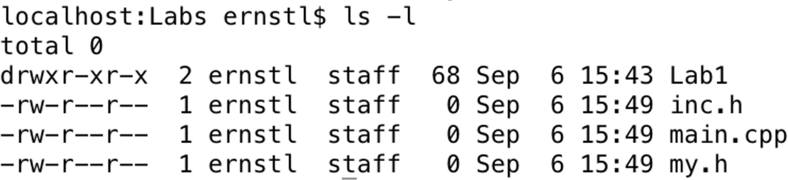
Part 7 – Security and Access Rights
Lab 1 - Linux/Unix Tutorial
14
▪
ls -l: list files in expanded form
d rwx r-x r-x : user group world
d : Directory (if it is file, it is “–”)
r : read
w : write
x : execute
Example: User: ernstl Group: staff
▪
▪
▪
▪
▪

Slide 22
Part 8 – Check Manuals
Lab 1 - Linux/Unix Tutorial
15
Man is an abbreviation for Manual
man <command> : will open the manual in the vim editor
Examples:
man ls
man cd man g++

Slide 23
Part 9 – Zipping Files and Directories
Lab 1 - Linux/Unix Tutorial
16
▪
zip and unzip command:
zip <filename.zip> <file>
zip -r <filename.zip> <directory>
unzip <filename.zip>
▪
Zip Bomb Issue
If your zip file is very large and triggers ZIPBOMB DETECTION, you can use the following method to unzip your file:
UNZIP_DISABLE_ZIPBOMB_DETECTION=TRUE unzip <filename.zip>

Slide 24
Extra Part – Additional Readings
Lab 1 - Linux/Unix Tutorial
18
Unix tutorial for beginners
https://users.cs.duke.edu/~alvy/courses/unixtut/
Learn Unix in 10 minutes
https://networking.ringofsaturn.com/Unix/learnUNIXin10minutes.php
Linux Commands Cheat Sheet
https://www.geeksforgeeks.org/linux-commands-cheat-sheet/
The Missing Semester, MIT CSAIL
https://www.youtube.com/@MissingSemester/videos

Slide 25
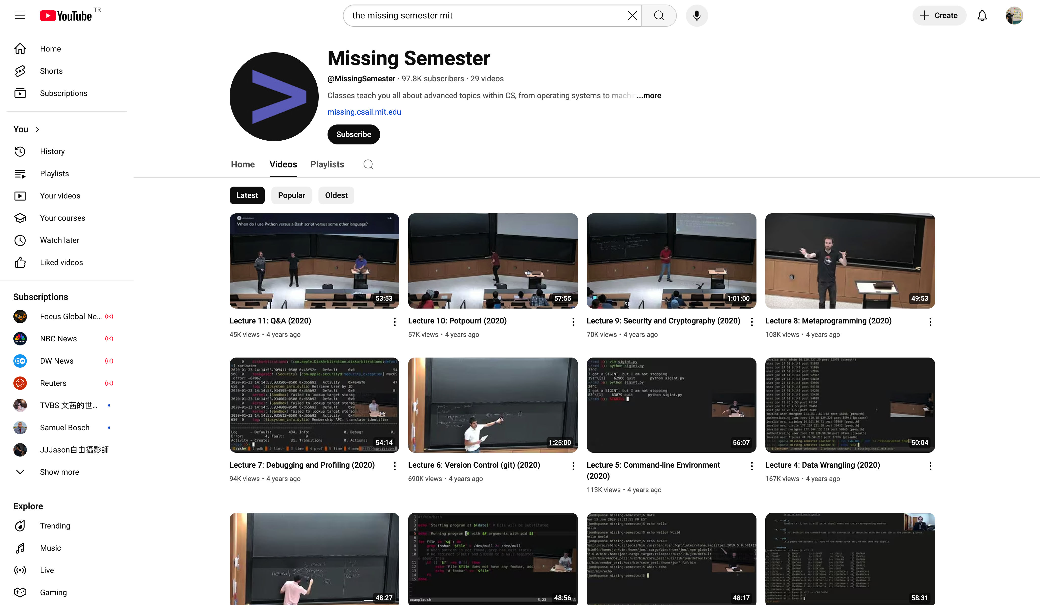
The Missing Semester, MIT CSAIL

Slide 26
Thank you very much for your attention!

